Slide 1
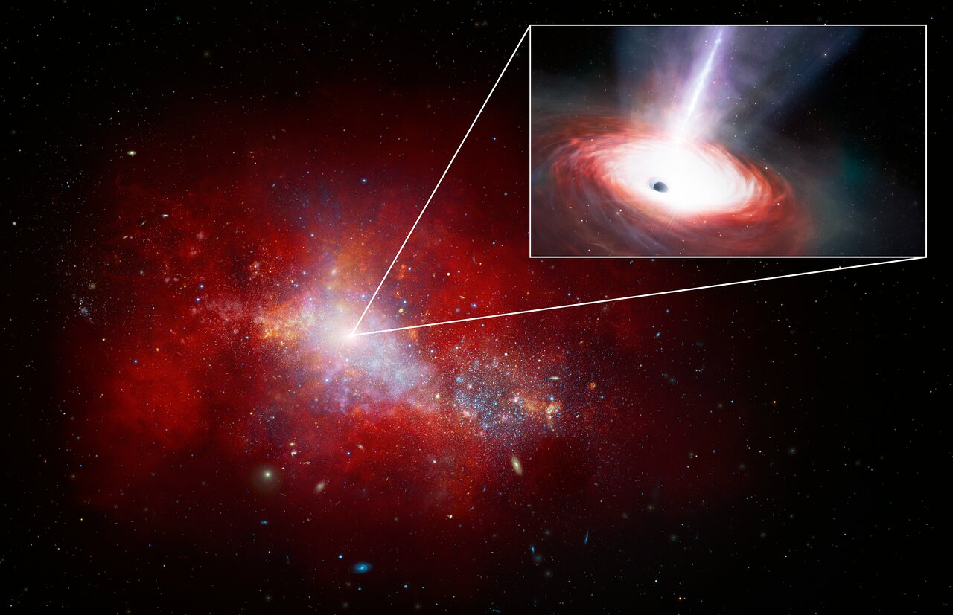


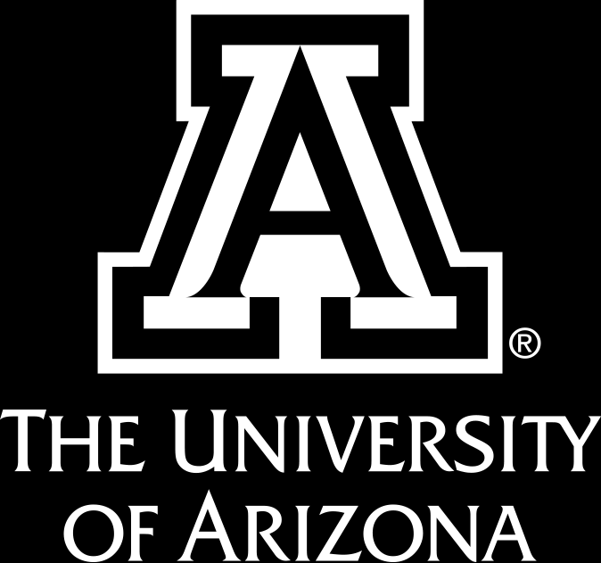
How Accretion Influences the Opening Angle of Ionization Cones in Seyfert 2 Galaxies
Rohin Sant (Advisor: Jacob Isbell)
Image credit: NOIRLab/NSF/AURA/J. da Silva/M. Zamani

Slide 2
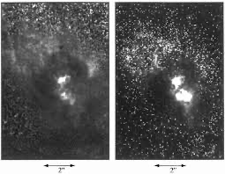
Introduction
Ionization Cone Structure
Active Galactic Nuclei (AGN) are powered by black holes and influence host galaxies.
Seyfert 2 AGN: Nucleus, particularly the dusty torus is viewed edge-on.
Ionization cone - an outflow of ionized gas starting near the nucleus.
Radiation from the accretion around the black hole escaping through a dusty torus.
We investigate the relationship between the accretion rate (Eddington ratio) and the opening angle of the cone.
Correlation expected from theory (Venanzi et al. 2020) but not been directly observed.
Hubble images of Ionization Cones of NGC 1068 (Capetti et al. 1997)

Slide 3
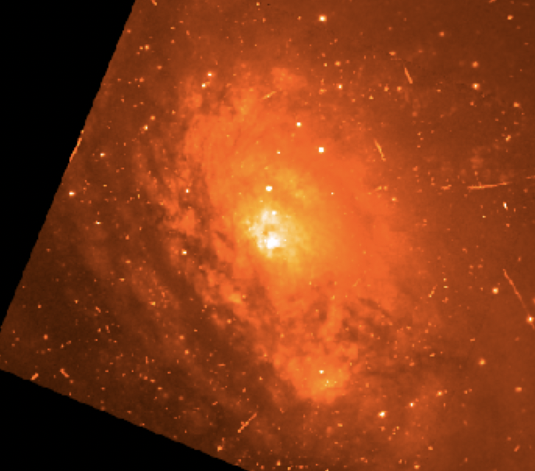
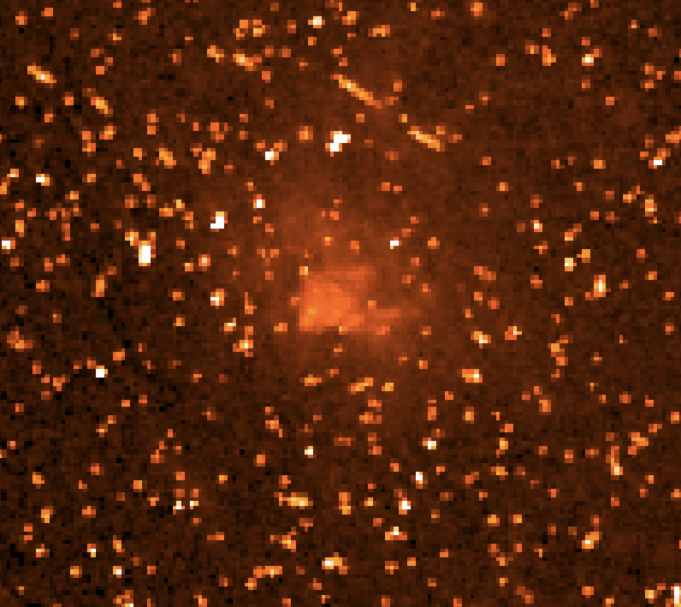
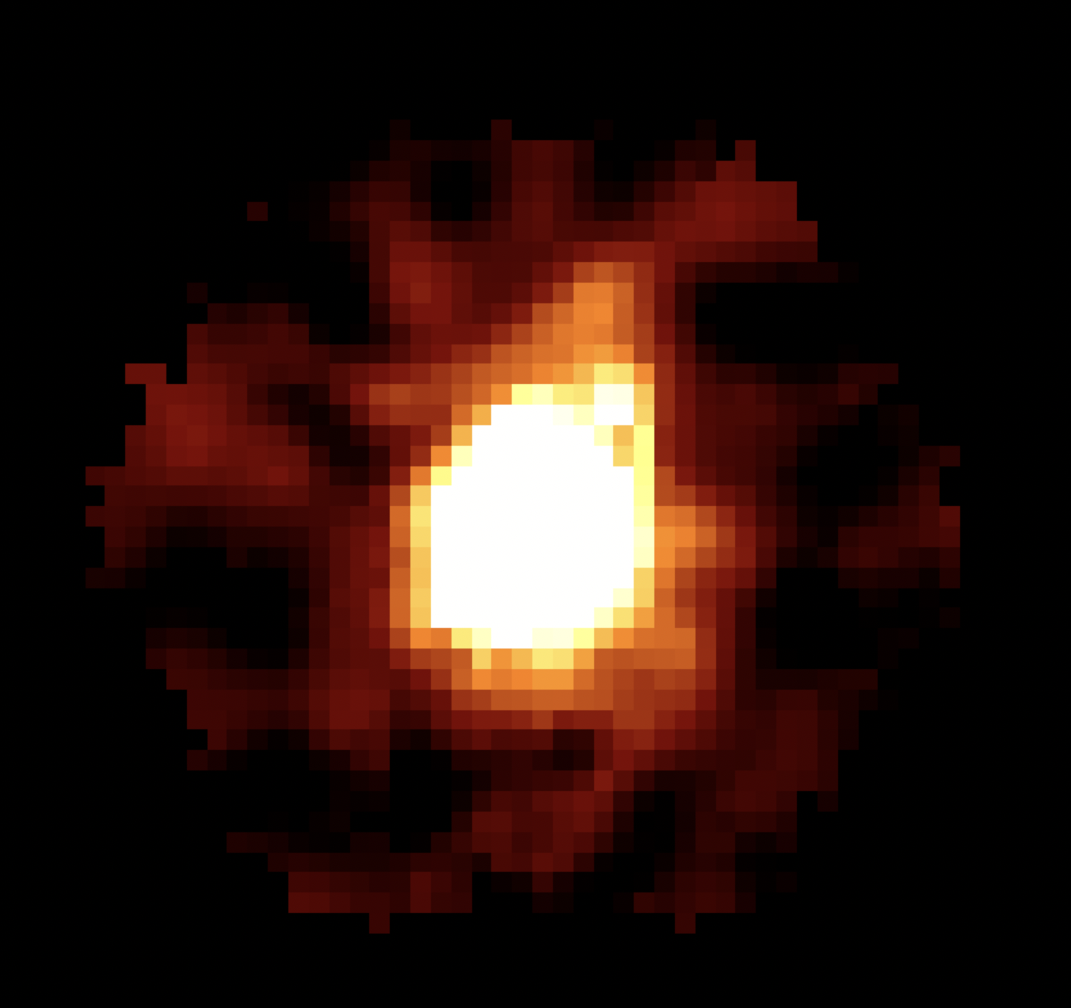
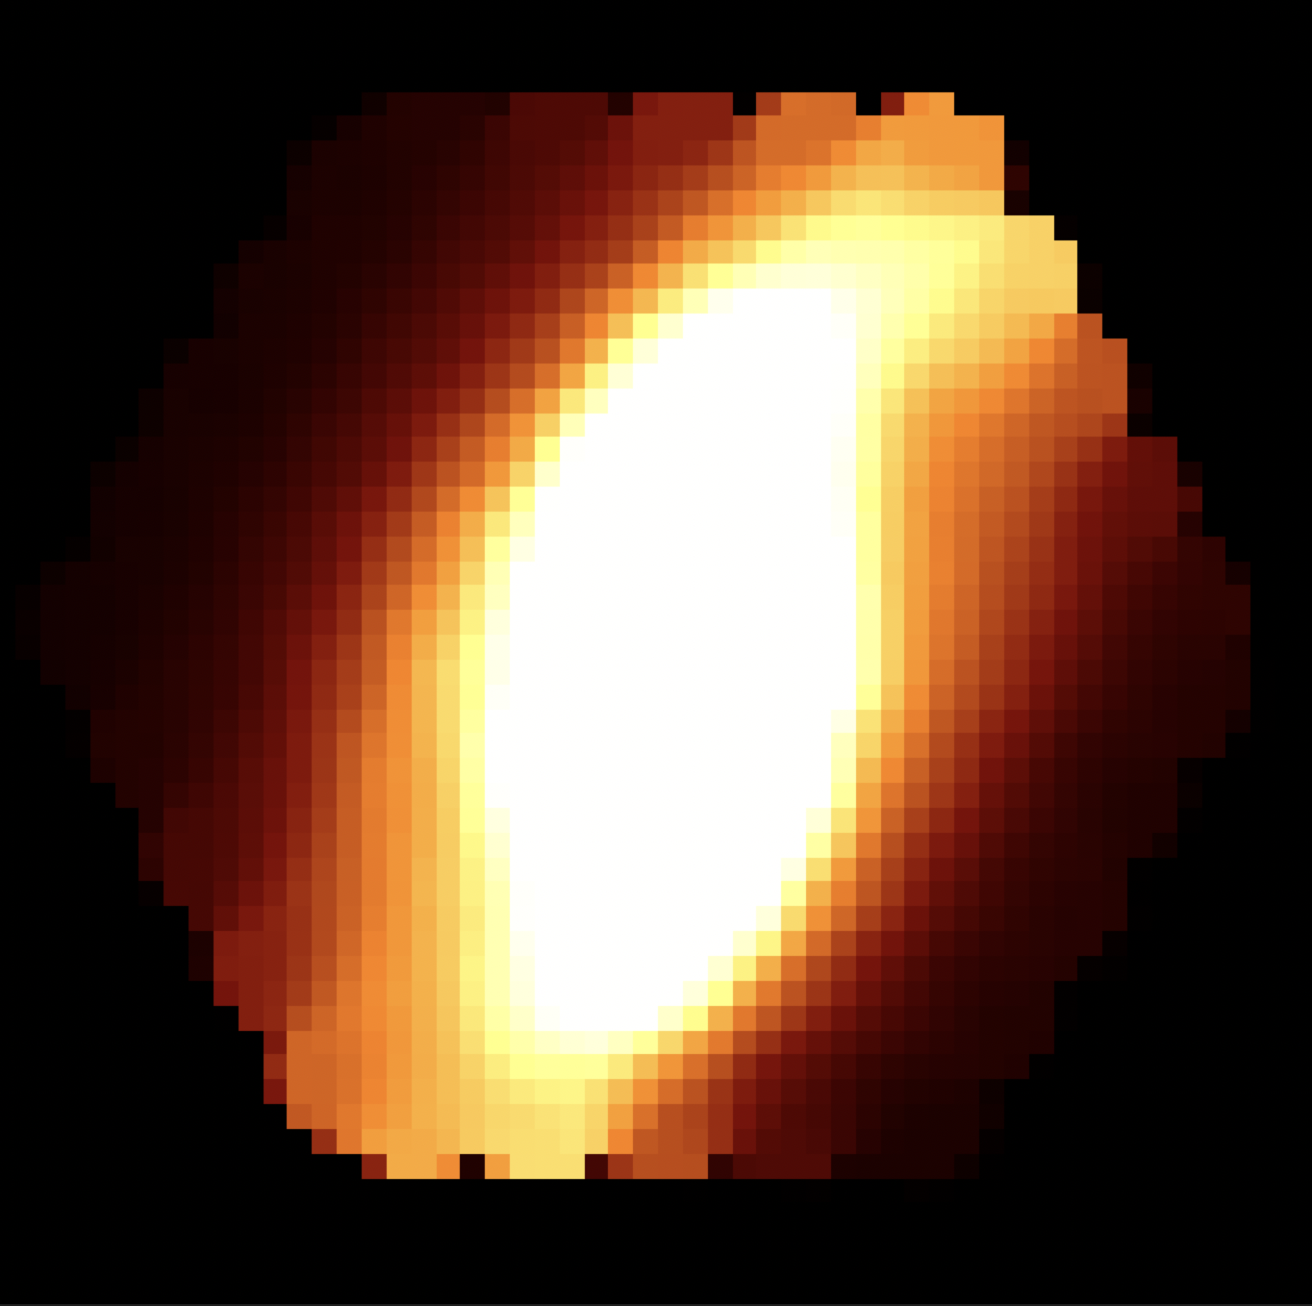
Data and Methods
Véron-Cetty (Véron-Cetty et al. 2010) and Asmus (Asmus et al. 2014) AGN catalogue - Seyfert 2 samples.
Hubble MAST archive - Continuum wavelength and [O III] emission line images.
[O III] emission line - Representative for ionization cone.
Marvin - Seyfert 2 samples from SDSS MaNGA catalogue.
5 Hubble and 59 MaNGA images found.
Eddington ratios found through literature.
Hubble image of Circinus in Continuum Wavelength
Hubble image of Circinus in [O III] Wavelength
MaNGA image of MARK 661 in Continuum Wavelength
MaNGA image of MARK 661 in [O III] Wavelength

Slide 4
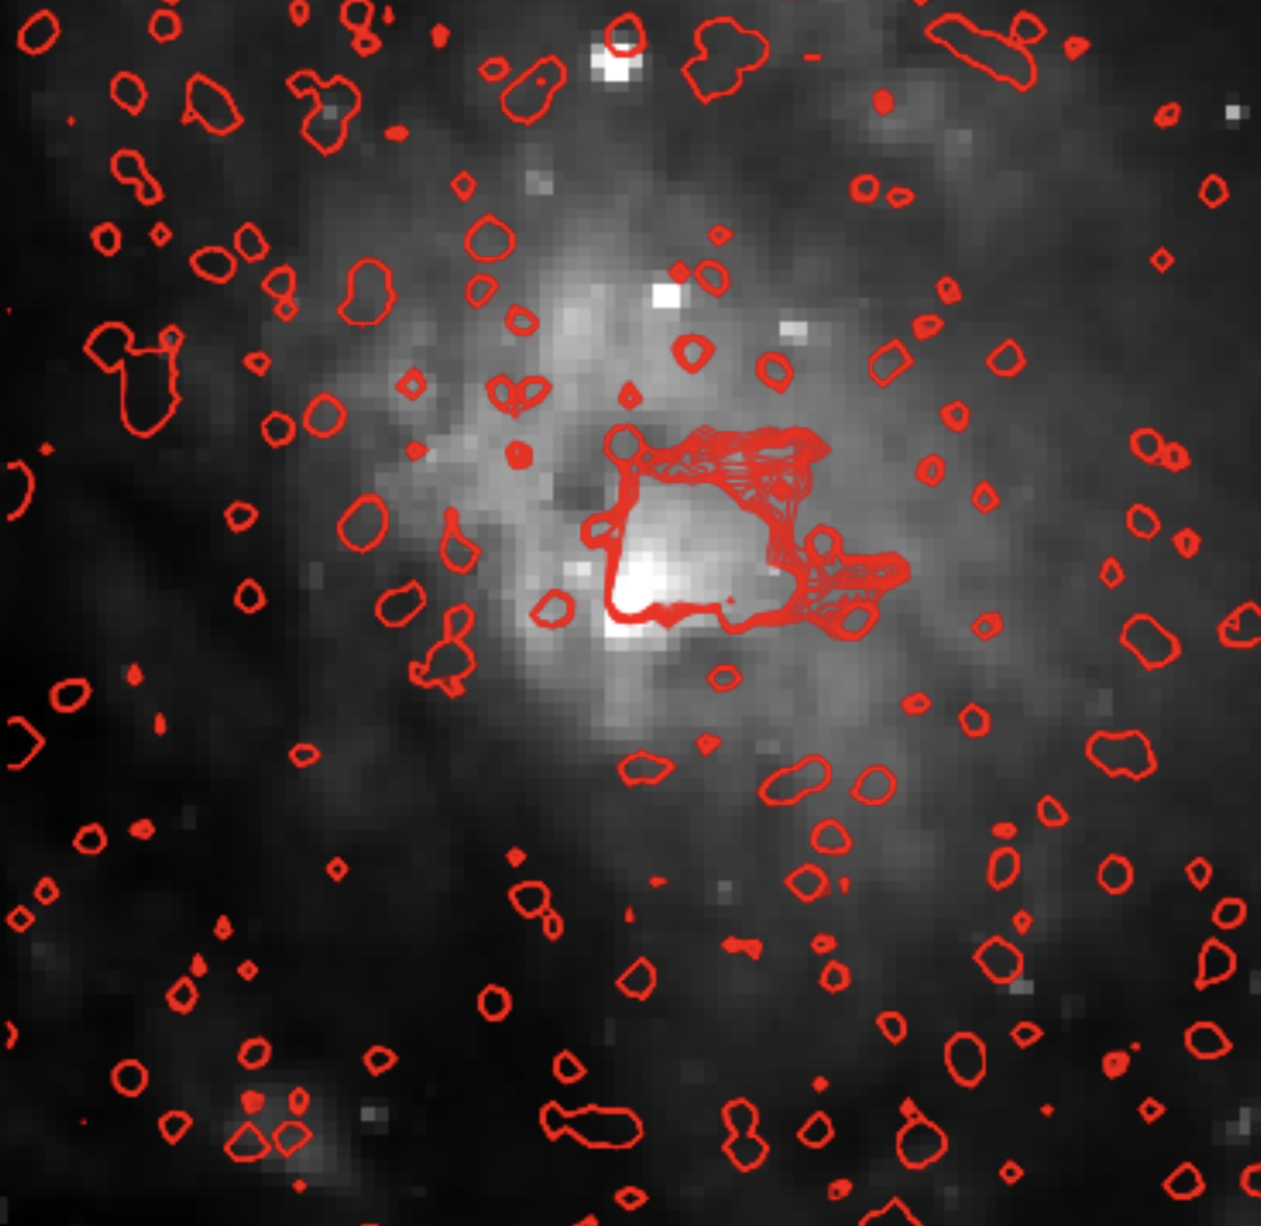
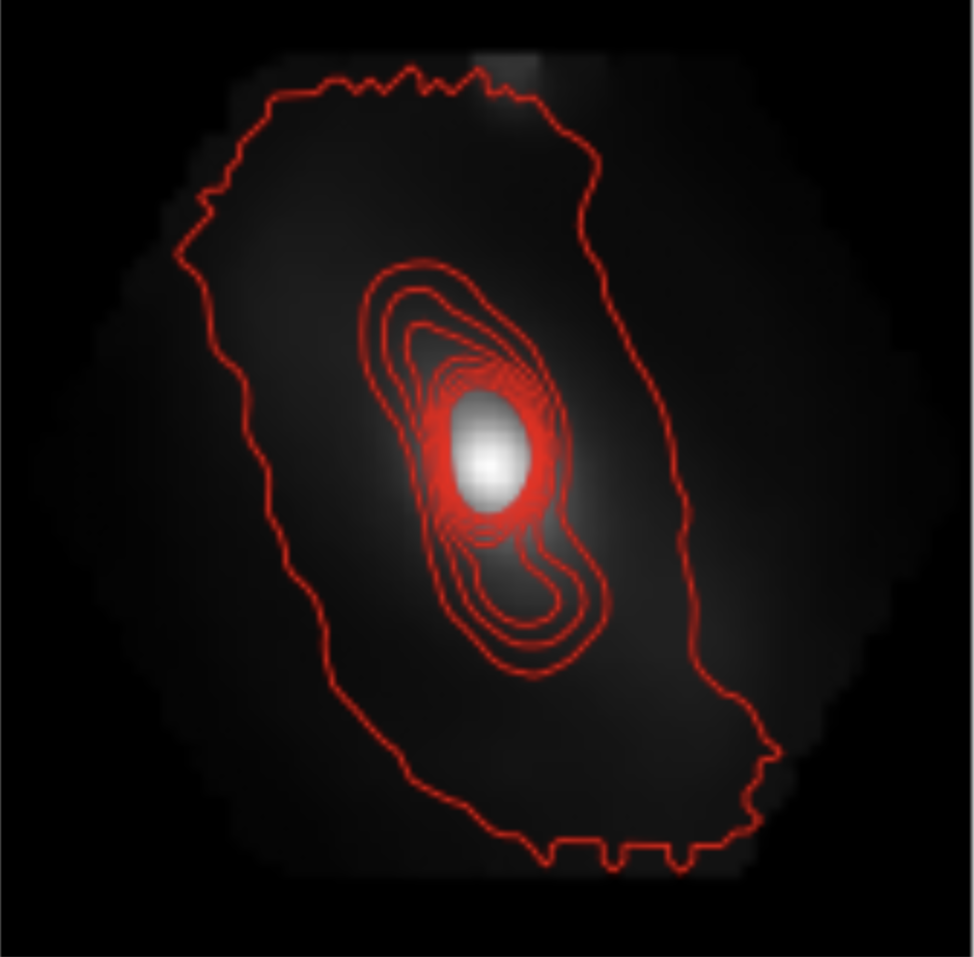
Methods
Traditional image processing techniques to subtract noise:
  Average over multiple images at each wavelength.
  Median subtraction.
  North alignment.
  Measured flux uncertainty using background standard deviation.
Computed SNR (signal-to-noise) images for each sample.
Overlaid [O III] SNR image as contours over continuum SNR image.
Continuum Hubble image of Circinus overlaid with [O III] contours
Continuum MaNGA image of NGC 6264 overlaid with [O III] contours

Slide 5
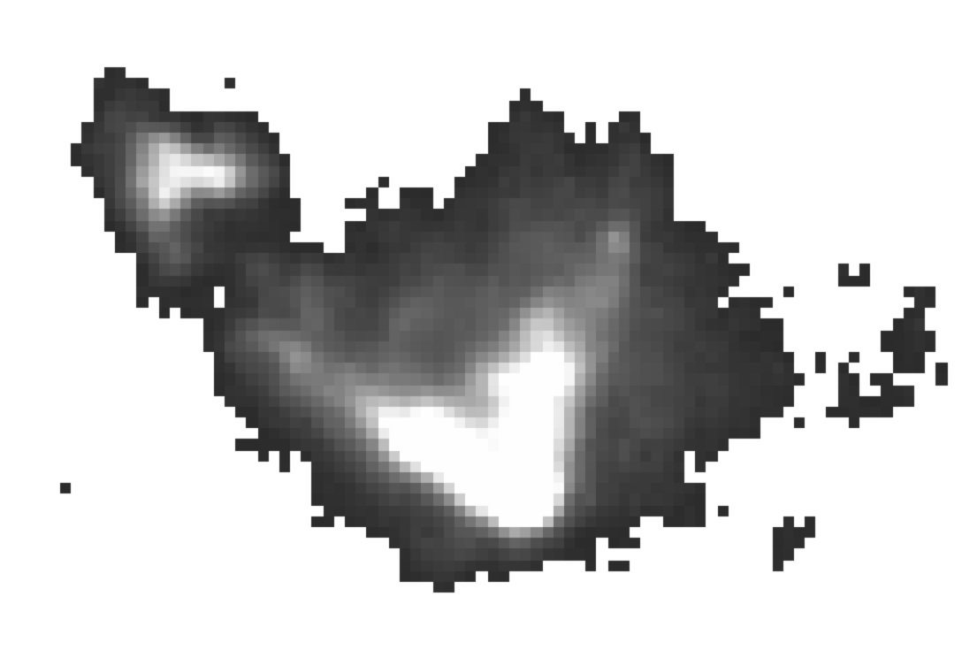
Opening Angle Measurement
Ex: Hubble Image for NGC 6300 at SNR = 17 (standard SNR threshold used for Hubble images)
Galaxy Name | Opening Angle (°)
NGC 1068 | 56.62
Circinus | 90.68
NGC 1386 | 42.83
NGC 5643 | 77.90
NGC 6300 | 63.30
Manually measuring angle

Slide 6
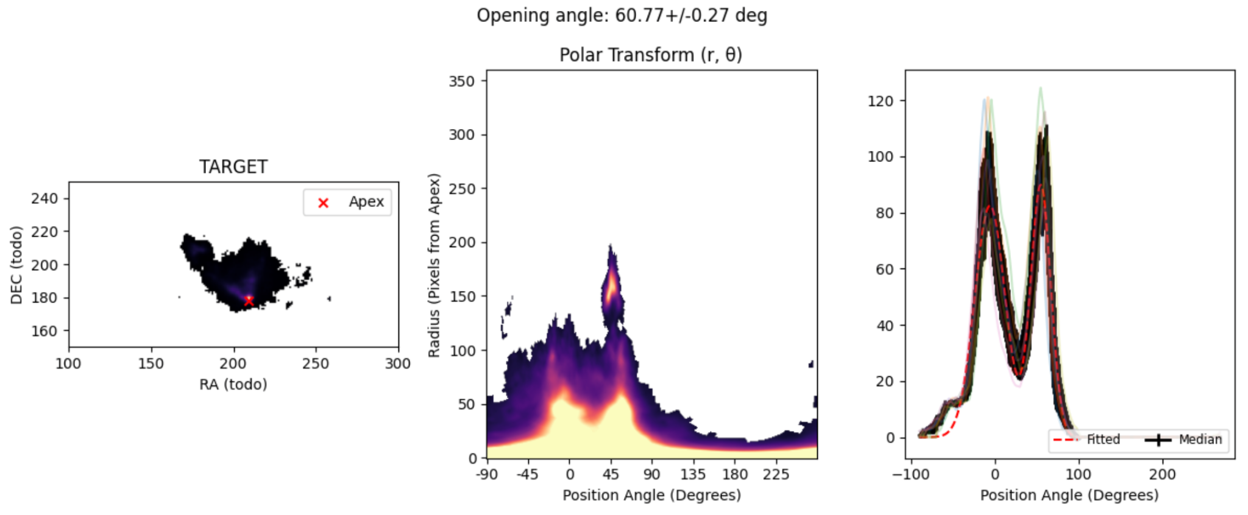
Opening Angle Measurement
Ex: Hubble Image for NGC 6300 at SNR = 17 (standard SNR threshold used for Hubble images)
Polar Coordinates Transformation and Model Fitting (currently in progress)

Slide 7
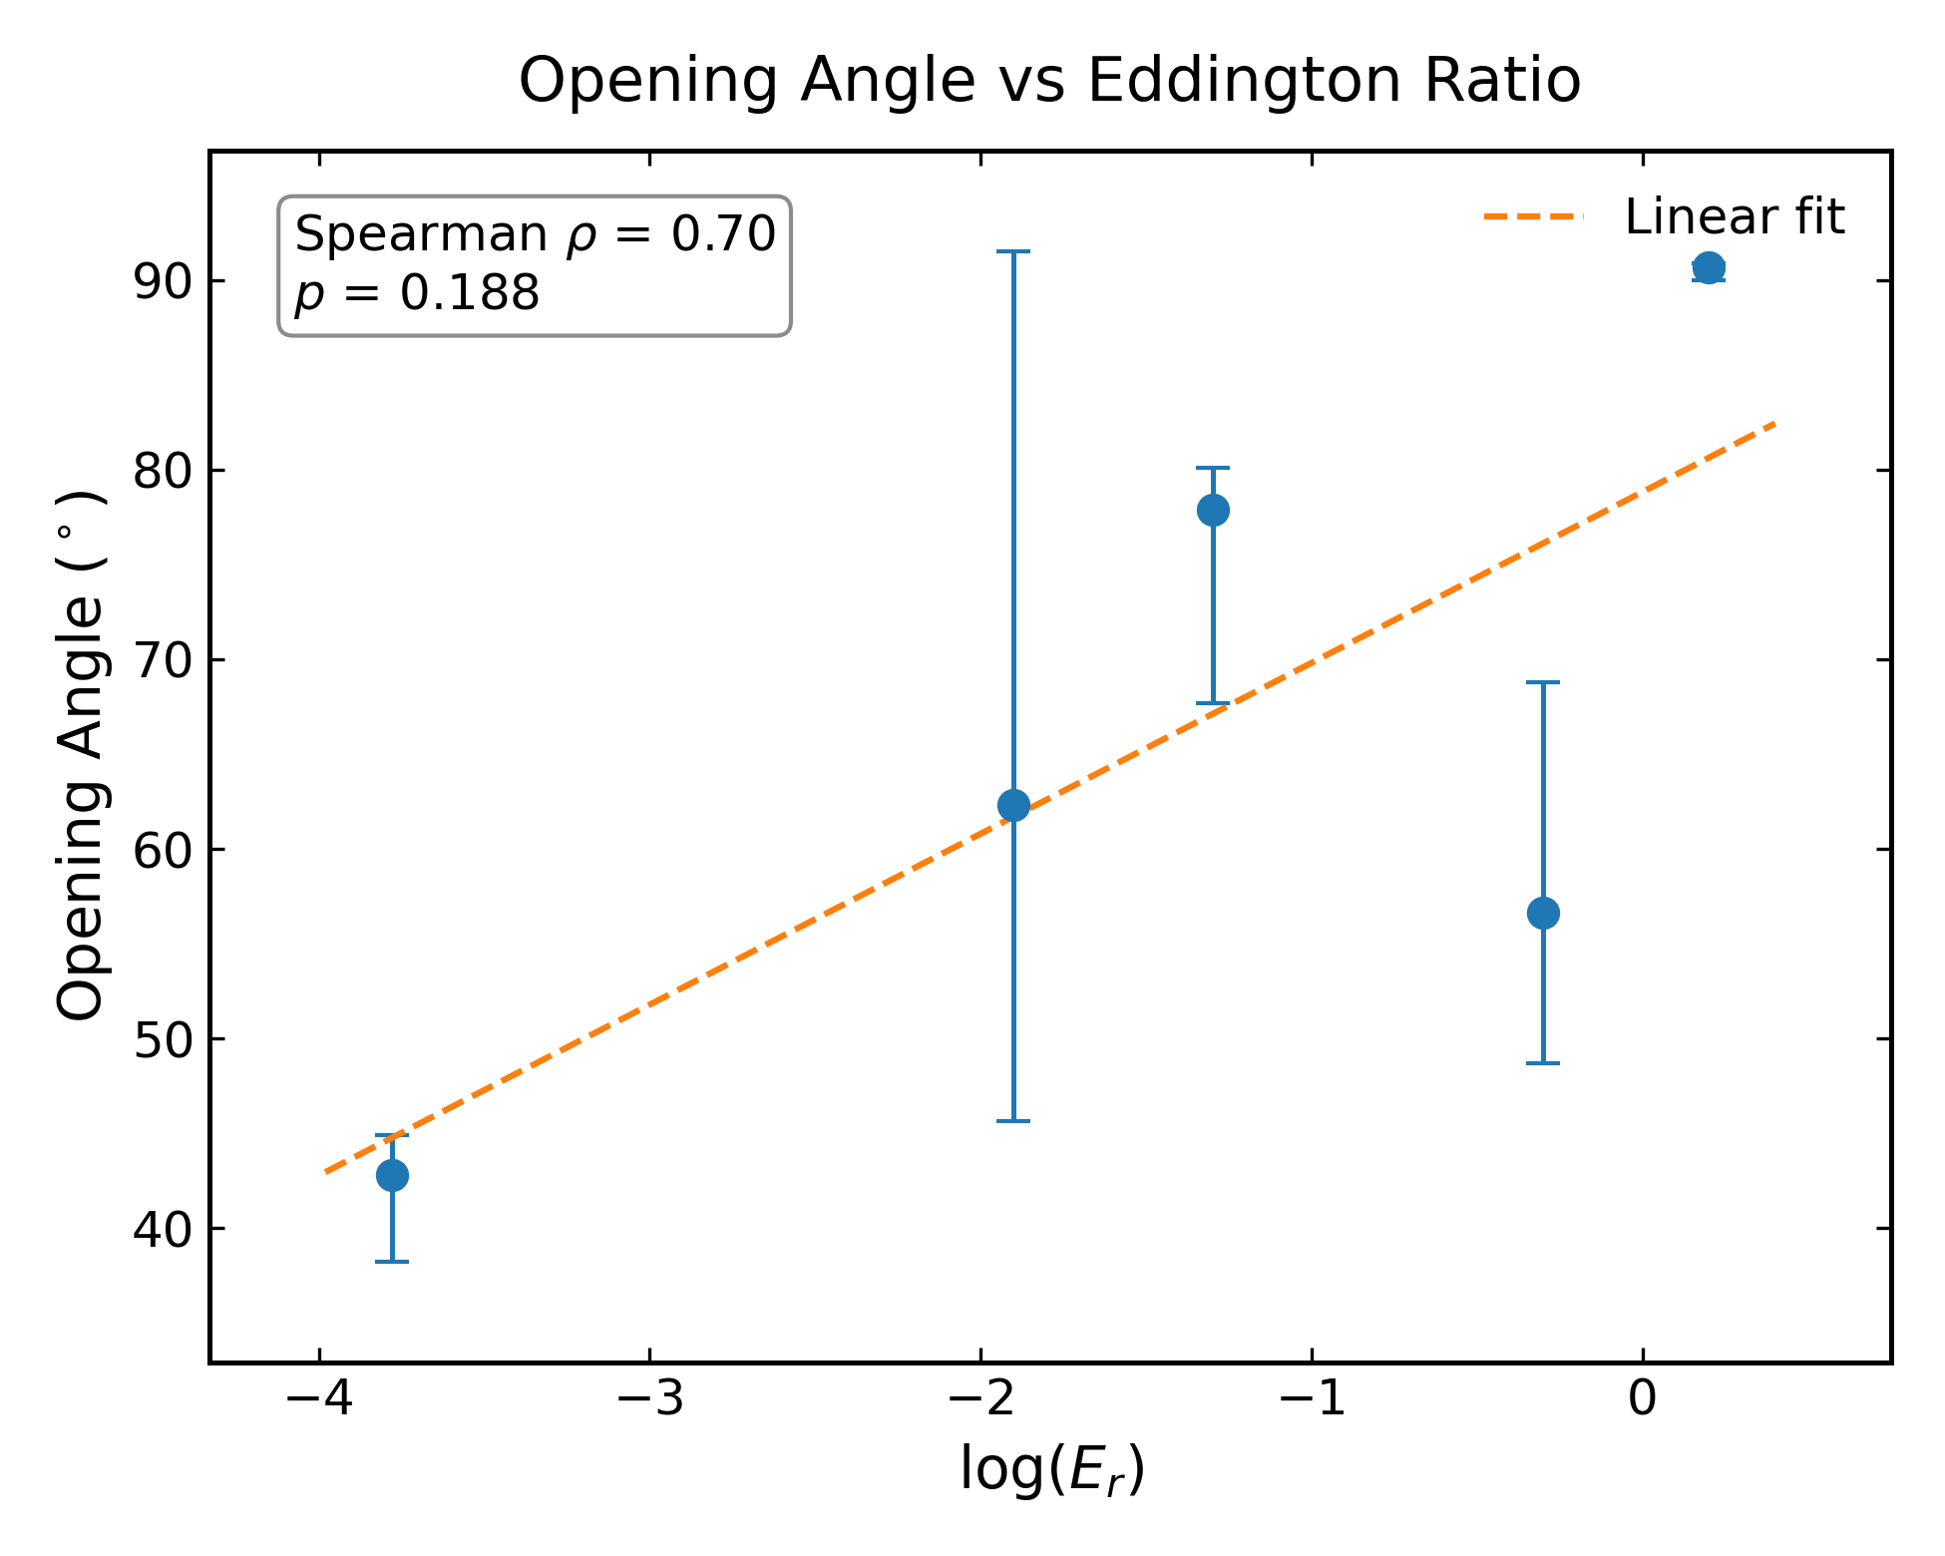
Results
Correlation seen between the quantities.
Uncertainties calculated by measuring angle in SNR ± 1 threshold.
Spearman coefficient of 0.7, suggests strong correlation.

Slide 8
Conclusions
There is a correlation between Eddington ratio (accretion rate) and the opening angle of ionization cone of Seyfert 2 Type AGN.
Used Hubble Space Telescope (HST) and SDSS MaNGA data to study samples.
Future Work:
  Making a robust pipeline to calculate the opening angle through polar coordinate transformation.
  Applying the pipeline to the SDSS MaNGA images.
  Find ways to reduce noise in images.

Slide 9
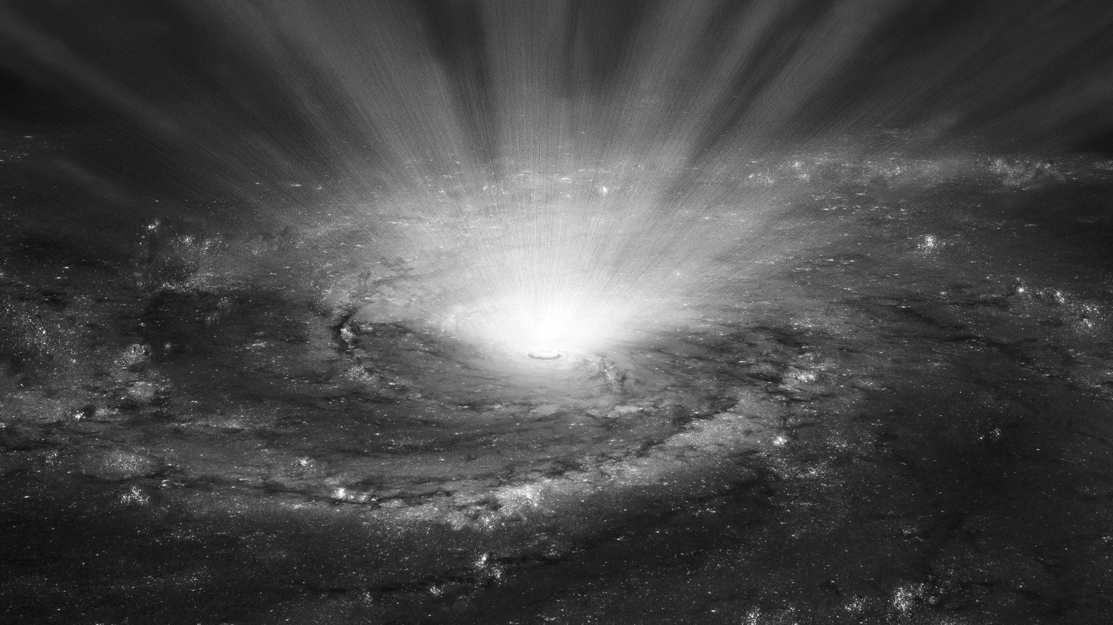
Acknowledgments
Thank you!
I thank Dr. Jacob Isbell for their immense guidance and support through this project. I also thank Dr. Steve Ertel for their support and funding. This work was funded by Arizona Space Grant Consortium.

